Slide 1
Web Engineering
Ms Nabeela Bibi

Slide 2
HTML Tables
In HTML, you can create tables for your website using the <table> tag in conjunction with the <tr>, <td> and <th> tags.
The HTML tables allow displaying the data (e.g. image, text, link) in columns and rows of cells. Table rows can be grouped into a head, foot, and body sections through the <thead>, <tfoot> and <tbody> elements, respectively.
In HTML5, we can place <tfoot> either before or after <tbody> tag. They must come after any <caption>, <colgroup>, and <thead> elements.
Most of the attributes of the <table> element are not used in HTML5. If you want to style the appearance of the table, you can use CSS instead.

Slide 3
Spanning Multiple Rows and Columns
It is possible to extend rows and columns of a table across many other rows and columns.
Commonly, a table cell cannot pass into the space, which is below or above another cell. But, if you want to span several rows or columns in a table, you can use the colspan or rowspan attributes.

Slide 4
Adding Captions to Tables
You can use the <caption> element to specify a caption for tables. It should be placed immediately after the opening <table> tag. By default, the caption will be at the top of the table, but its position can be changed with the CSS caption-side property.

Slide 5
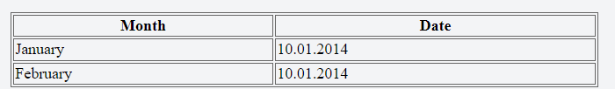
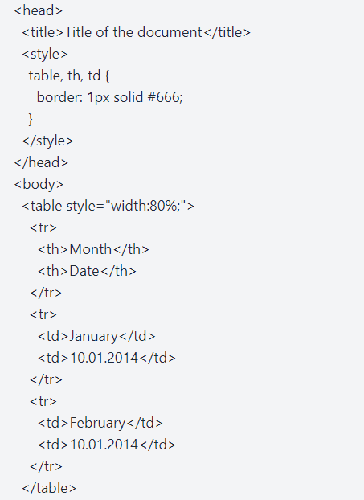
Syntax
In the given example, we use the <table> tag to create a table. Then, we use the <tr> tag to divide the table into rows. The <th> tag is used for the table header cells, where the title is written. In other words, the table row is divided into headings. The <td> tag is used for table cells where the information is written.

Slide 6
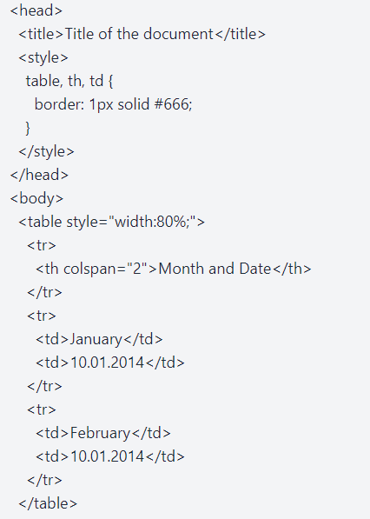
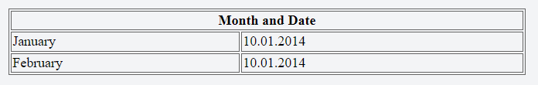
HTML colspan attribute

Slide 7
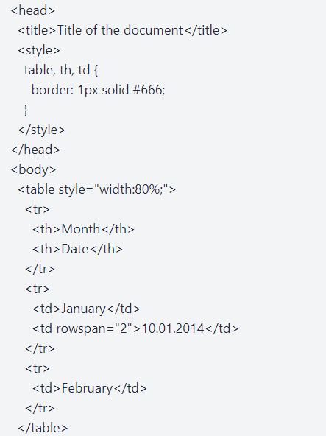
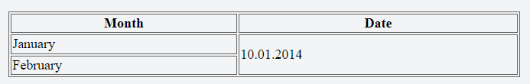
HTML rowspan attribute

Slide 8
List tag in HTML
Unordered lists - bullet points
Ordered lists - sequence of numbers or letters
Definition lists - term and its definition

Slide 9
Unordered Lists
<ul>
<li>Bullet point number one</li>
<li>Bullet point number two</li>
<li>Bullet point number three</li>
</ul>

Slide 10
Ordered Lists
<ol>
<li>Point number one</li>
<li>Point number two</li>
<li>Point number three</li>
</ol>
<ol type="i">

Slide 11
Ordered list
<ol type="i">
1 - Arabic numerals - 1, 2, 3, 4, 5
A - Capital letters - A, B, C, D, E
a - Small letters - a, b, c, d, e
I - Large Roman numerals - I, II, III
i - Small Roman numerals - i, ii, iii, iv

Slide 12
Ordered list
<ol type="i" start="4">
<li>Point number one</li>
<li>Point number two</li>
<li>Point number three</li>
</ol>

Slide 13
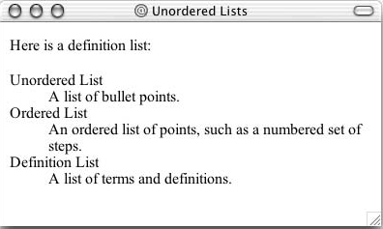
Definition Lists
<dl>
<dt>Unordered List</dt>
<dd>A list of bullet points.</dd>
<dt>Ordered List</dt>
<dd>An ordered list of points, such as a numbered set of steps.</dd>
<dt>Definition List</dt>
<dd>A list of terms and definitions.</dd>
</dl>

Slide 14
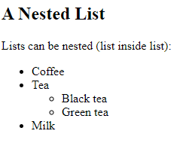
Nested List
<!DOCTYPE html>
<html>
<body>
<h2>A Nested List</h2>
<p>Lists can be nested (list inside list):</p>
<ul>
<li>Coffee</li>
<li>Tea
<ul>
<li>Black tea</li>
<li>Green tea</li>
</ul>
</li>
<li>Milk</li>
</ul>
</body>
</html>

Slide 15

Exercise
Heading 1
This is bold italic red underline text
Ordered list
One
Two
Three
Unordered list
1st
2nd
3rd
Preformatted text
This text contains extra spaces

Slide 16


